Slide 1
APAC Space Collaboration
Jia-Rong Low, ICANN APAC
AP* Retreat
28 February 2021

Slide 2
Agenda
About APAC Space
APAC Space 2.0
Possible Collaboration Areas
Discussion

Slide 3
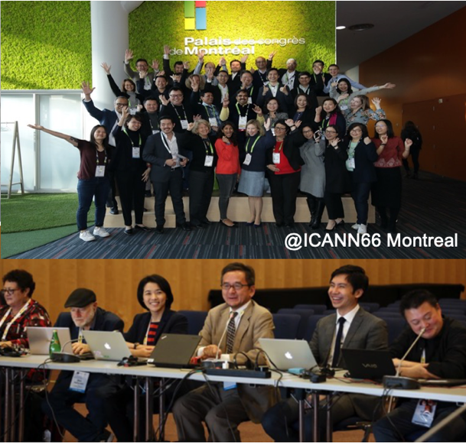
About APAC Space
A “space” for ICANN APAC community members
Started 2015, hosted by ICANN APAC Office with support from DotAsia
Community-led discussions. Practice ground to facilitate community discussion for ICANN participation:
DNS-related topics (e.g. Root Server System)
ICANN Policy Development Processes (PDPs), Public Comments, and Reviews
ICANN Meeting Readouts
Sessions every 2 months
Web conference or
Face-to-face at ICANN Meetings
Also, mailing list circulations on relevant topic events/webinars (e.g. Universal Acceptance, DNS abuse)
@ICANN66 Montreal
Learn more: apacspace.asia
Join the mailing list: subscribe@apacspace.asia

Slide 4
APAC Space 2.0 – Widening the Network
We are working towards featuring new topics and deepening discussion within the APAC community network. Initial ideas:
Root Server System (RSS)
Regional Mentorship Program
Introducing the basics of the RSS
Keep the community updated on how the RSS is evolving
Create awareness and encourage participation on the governance of RSS (e.g. RSSAC caucus)
Link ICANN ‘regulars’ with ‘veterans’
Foster participation in ICANN Policy Making

Slide 5
Other Potential Areas
1. DNS operations and security
Enhance knowledge about DNS operations and security
Promotion of global Internet standards (DNSSEC, IPv6, Internationalised Domain Names (IDNs) and Universal Acceptance (UA) etc)
2. Digital Initiatives
Sharing of the digital landscape in your economy/region
Exchange views on potential opportunities (initiatives) and challenges for the Internet industry

Slide 6
Possible Collaboration Areas
Suggest topics
Come and speak at APAC Space, or recommend speaker(s)
Direct APAC Space community to your platform on common topics
Explore cross-forum synergies

Slide 7
Engage with ICANN
Thank You and Questions
Visit us at icann.org
Email: jiarong.low@icann.org
Learn more: apacspace.asia
Join the mailing list: subscribe@apacspace.asia
@icann
linkedin/company/icann
facebook.com/icannorg
slideshare/icannpresentations
youtube.com/icannnews
soundcloud/icann
flickr.com/icann
instagram.com/icannorg

